Slide 1
CHAPTER 1 HUMAN INQUIRY AND SCIENCE

Slide 2
Chapter Outline
Introduction
Looking for Reality
The Foundation of Social Science
Some Dialectics of Social Research
Chapter Summary
Questions

Slide 3
Looking for Reality (slide 1 of 5)
Knowledge from Agreement Reality
Assertions must be both logical and empirical.
Epistemology – The science of knowing.
Methodology – A subfield of epistemology.

Slide 4
Looking for Reality (slide 2 of 5)
Ordinary Human Inquiry
Humans want to predict the future. Why?
We recognize that the future is caused in part by the present.
But also that cause and effect patterns are probabilistic in nature.
Prediction versus Understanding
Tradition
Authority

Slide 5
Looking for Reality (slide 3 of 5)
Errors in Inquiry and Some Solutions
Inaccurate Observations
Measurement devices offer accuracy.
Overgeneralizations
Large and representative samples are a safeguard against overgeneralization.
Replication – Repeating a research study to test and either confirm or question the findings of an earlier study.

Slide 6
Looking for Reality (slide 4 of 5)
Selective Observations
Avoid looking for “deviant” cases.
Illogical Reasoning
“Gambler’s fallacy”

Slide 7
Looking for Reality (slide 5 of 5)
What’s Really Real?
The Premodern View – Things are as they seem.
The Modern View – Acknowledgement of human subjectivity.
The Postmodern View – There is no objective reality.

Slide 8
The Foundations of Social Science
The foundations of social science are logic and observation.

Slide 9
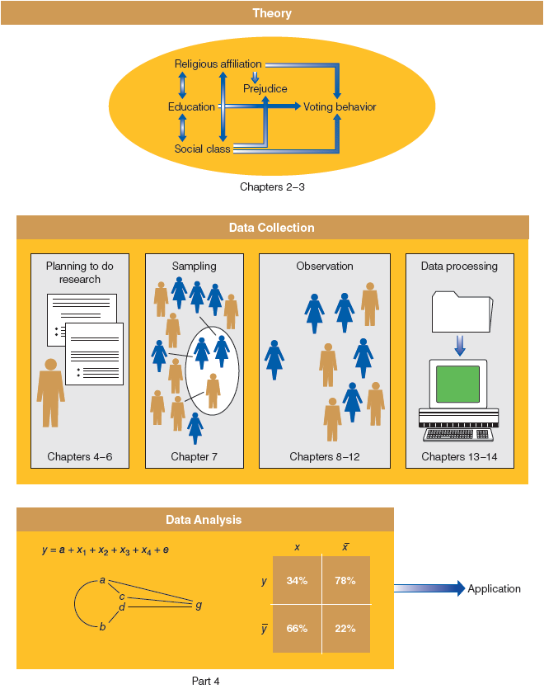
Figure 1-1
Social Science = Theory + Data Collection + Data Analysis
This figure offers a schematic overview of the major stages of social research, indicating where each is discussed in this book.

Slide 10
The Foundations of Social Science (slide 1 of 4)
Theory, Not Philosophy or Belief
Social theory has to do with what is, not with what should be.
Theory – A systematic explanation for the observations that relate to a particular aspect of life.
Social science can help us know what is and why.

Slide 11
The Foundations of Social Science (slide 2 of 4)
Social Regularities
Exceptions?
Social regularities represent probabilistic patterns.

Slide 12
The Foundations of Social Science (slide 3 of 4)
Aggregates, Not Individuals
The collective actions and situations of many individuals.
Focus of social science is to explain why aggregated patterns of behavior are regular even when individuals change over time.

Slide 13
The Foundations of Social Science (slide 4 of 4)
Concepts and Variables
Attributes – Characteristics or qualities that describe an object.
Variables – Logical groupings of attributes. The larger category to which those attributes belong.

Slide 14
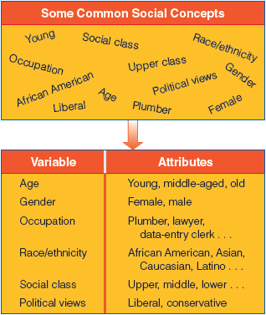
Figure 1-2
Variables and Attributes
Variables like education and prejudice and their attributes (educated/uneducated, prejudiced/unprejudiced) provide the foundation for examining causal relationships in social research.

Slide 15
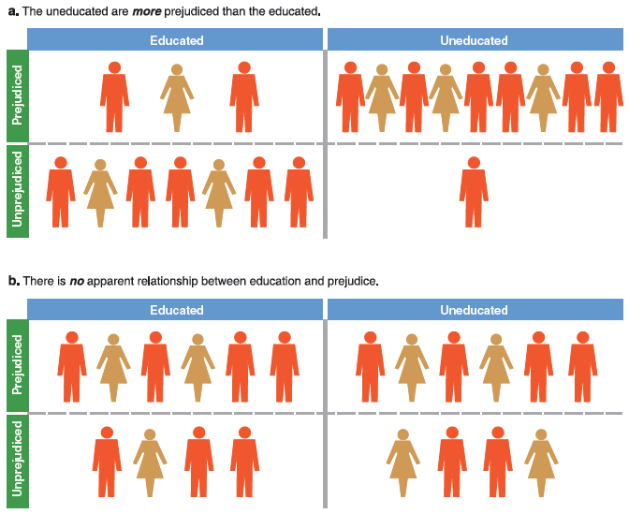
Figure 1-3
Illustration of Relationship between Two Variables (Two Possibilities)
Variables such as education and prejudice and their attributes (educated/uneducated, prejudiced/unprejudiced) are the foundation for the examination of causal relationships in social research.

Slide 16
The Foundations of Social Science (slide 1 of 2)
Independent Variable – A variable with values that are taken as simply given. A variable that influences another. Predictor.
Dependent Variable – A variable assumed to depend on or be caused by another. Outcome.

Slide 17
The Foundations of Social Science (slide 2 of 2)
The Purposes of Social Research
Mapping out a topic that may warrant further study later (exploratory)
Describing the state of social affairs (descriptive)
Providing reasons for phenomena, in terms of causal relationships (explanatory)
The Ethics of Human Inquiry
Ethical dimension presented throughout the text.

Slide 18
Some Dialectics of Social Research (slide 1 of 2)
Idiographic and Nomothetic Explanation
Idiographic – explanation that exhausts the many idiosyncratic causes for a particular event.
Nomothetic – explanation that identifies one or a few causal factors that generally impact a class of events.

Slide 19
Some Dialectics of Social Research (slide 2 of 2)
Inductive and Deductive Theory
Induction – logical argument in which general principles are developed from specific observations/data.
Deduction – logical argument in which specific expectations of hypotheses are developed on the basis of general principles/other theories.

Slide 20
Some Dialectics of Social Research
Qualitative and Quantitative Data
Qualitative Data – non-numerical data
Quantitative Data – numerical data

Slide 21
Chapter Summary
Identify the different ways people decide what’s real.
Explain the fundamental nature of social science.
Understand the basic options for conducting social science research.

